Slide 1

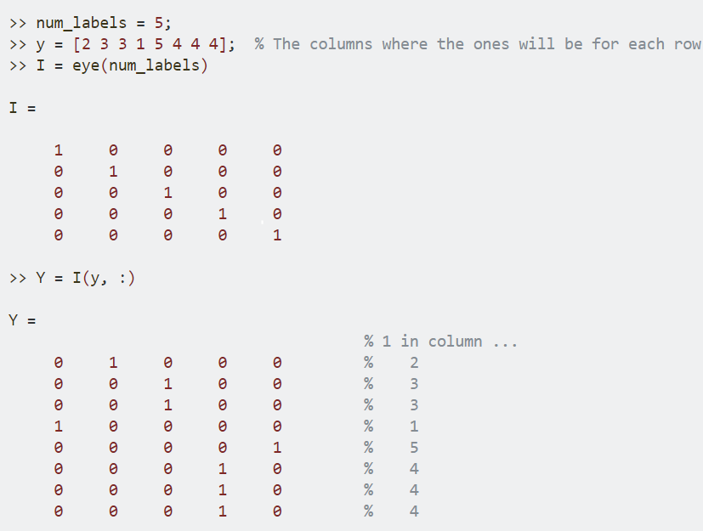
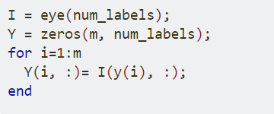
Create a matrix for y
y → an m-element vector containing integers in the range of 1 to num_labels. The goal of the code is to create a matrix Y that is m-by-num_labels where each row k will contain all zeros except for a 1 in column y(k).
Create an identity matrix using the function eye. This is a square matrix of all zeroes except for ones along the main diagonal. Row k of the identity matrix will therefore have one non-zero element in column k. We can therefore build matrix Y out of rows indexed from the identity matrix, using y as the row index.
We could do this with a for loop (as in your second code sample), but that's not as simple and efficient as using a single indexing operation (as in your first code sample).

Slide 2
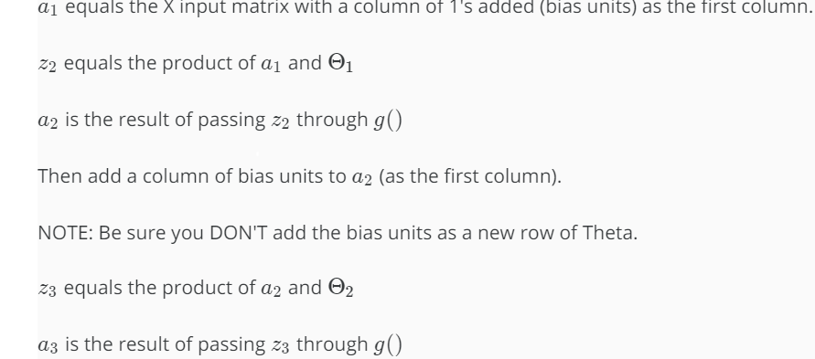
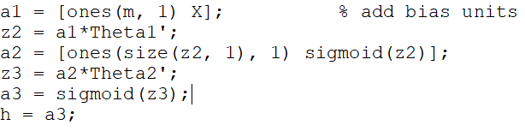
Forward propagation
Though this was already accomplished once during Exercise 3, you'll need to duplicate some of that work because computing the gradients requires some of the intermediate results from forward propagation. Also, the y values in ex4 are a matrix, instead of a vector. This changes the method for computing the cost J.

Slide 3
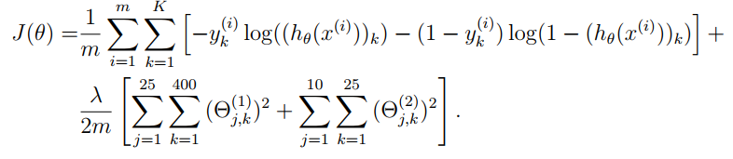
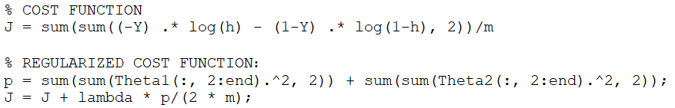
Compute Cost Function - Regularization
Cost function:
Compute the unregularized cost according, using a3, your Y(y_matrix), and m (the number of training examples). Note that the 'h' argument inside the log() function is exactly a3. Cost should be a scalar value. Since y_matrix and a3 are both matrices, you need to compute the double-sum.
Remember to use element-wise multiplication with the log() function.
Why you can't (easily) use matrix multiplication here, :
Notice the double-sum. 'i' ranges over the training examples 'm', and 'k' ranges over the output labels 'K'. The cost has two parts - the first involves the product of 'y' and log(h), and the second involves the product of (1-y) and log(1-h). Note that 'y' and 'h' are both matrices of size (m x K), and the multiplication in the cost equation is an element-wise scalar product for each element in the matrices.
Also, we're using the natural log, not log10().
Cost Regularization:
Compute the regularized component of the cost according to ex4.pdf Page 6, using Θ1 and Θ2 (excluding the Theta columns for the bias units), along with λ, and m. The easiest method to do this is to compute the regularization terms separately, then add them to the unregularized cost from Step 3.

Slide 4
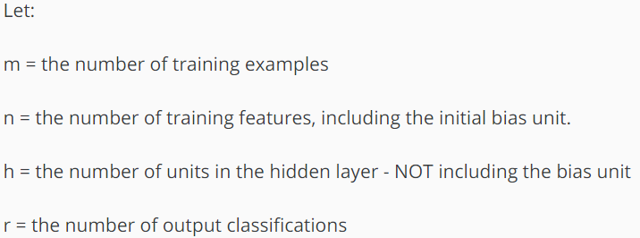
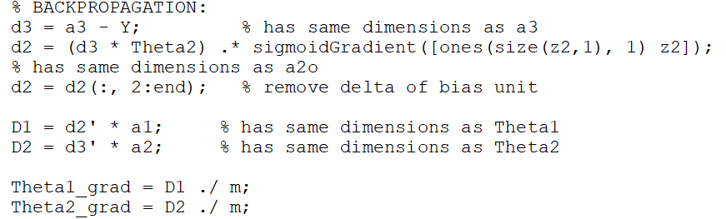
Backward propagation
d3 = the difference between a3 and the Y(y_matrix). The dimensions are the same as both, (m x r).
z2 comes from the forward propagation process - it's the product of a1 and Theta1, prior to applying the sigmoid() function. Dimensions are (m x n) ⋅ (n x h) --> (m x h). In step 4, you're going to need the sigmoid gradient of z2. If u = sigmoid(z2), then sigmoidGradient(z2) = u .* (1-u).
d2 is tricky. It uses the (:, 2:end) columns of Theta2. d2 is the product of d3 and Theta2 (without the first column), then multiplied element-wise by the sigmoid gradient of z2. The size is (m x r) ⋅ (r x h) --> (m x h). The size is the same as z2.
Note: Excluding the first column of Theta2 is because the hidden layer bias unit has no connection to the input layer - so we do not use backpropagation for it.
D1 is the product of d2 and a1. The size is (h x m) ⋅ (m x n) --> (h x n)
D2 is the product of d3 and a2. The size is (r x m) ⋅ (m x [h+1]) --> (r x [h+1])
Theta1_grad and Theta2_grad are the same size as their respective Deltas, just scaled by 1/m.
Now you have the unregularized gradients. Check your results using ex4.m, and submit this portion to the grader.

Slide 5
Backward propagation - Regularization
Since Theta1 and Theta2 are local copies, and we've already computed our hypothesis value during forward-propagation, we're free to modify them to make the gradient regularization easy to compute.
So, set the first column of Theta1 and Theta2 to all-zeros.
Scale each Theta matrix by λ/m. Use enough parenthesis so the operation is correct.
Add each of these modified-and-scaled Theta matrices to the un-regularized Theta gradients that you computed earlier.
---------------------
Appendix:
Here are the sizes for the Ex4 digit recognition example, using the method described in this tutorial.
a1: 5000x401
z2: 5000x25
a2: 5000x26
a3: 5000x10
d3: 5000x10
d2: 5000x25
Theta1, D1 and Theta1_grad: 25x401
Theta2, D2 and Theta2_grad: 10x26

